Slide 1

iNeuron.ai

Slide 2

Use Cases
Banking and Finance
Insurance and Claims
.
Human Resource and workforce management
.
Domain Specific Use Cases
Optimization of operations and management
Retail, supply chain, inventory management etc.
.
Customer data-oriented marketing

Slide 3
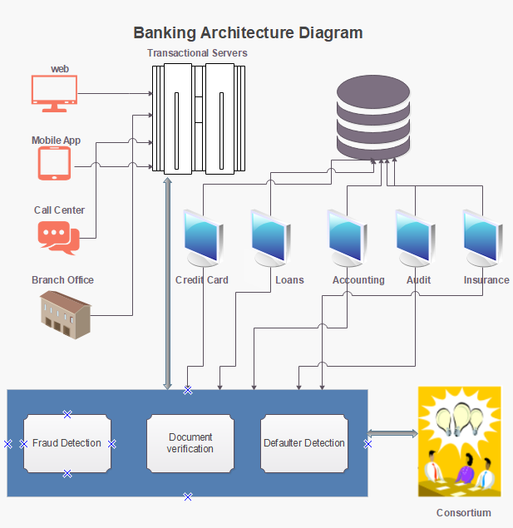
Banking System Architecture

Slide 4
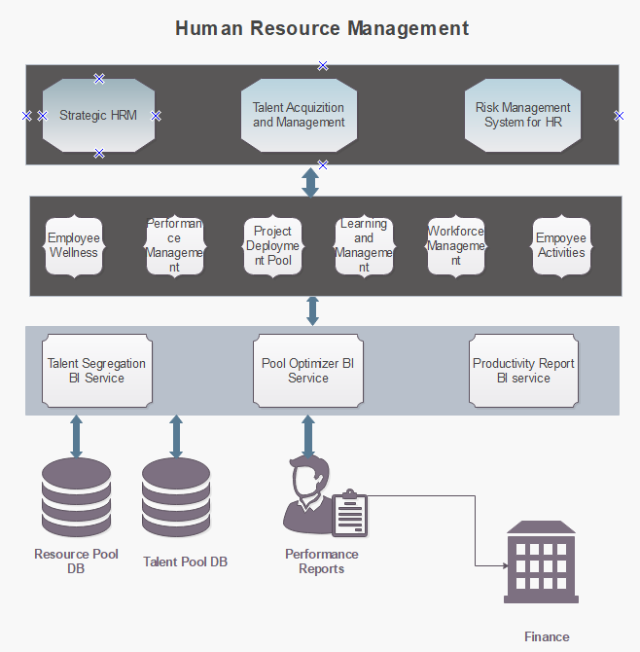
HR System Architecture

Slide 5
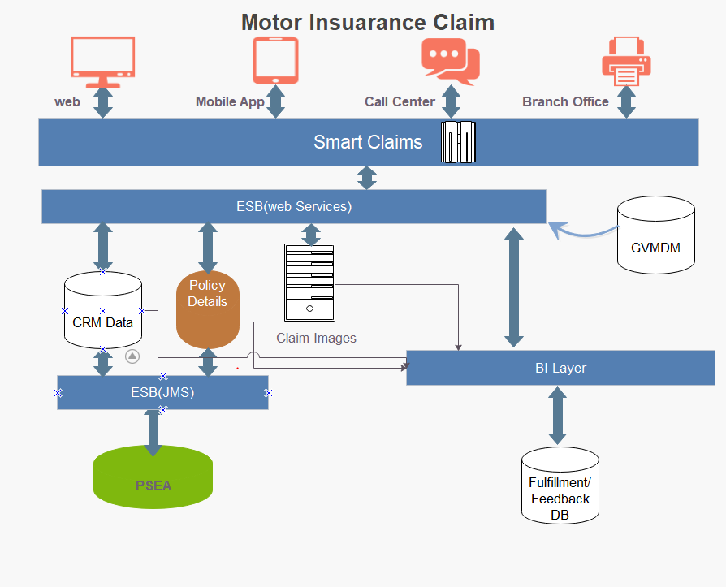
Insurance Claim Architecture

Slide 6
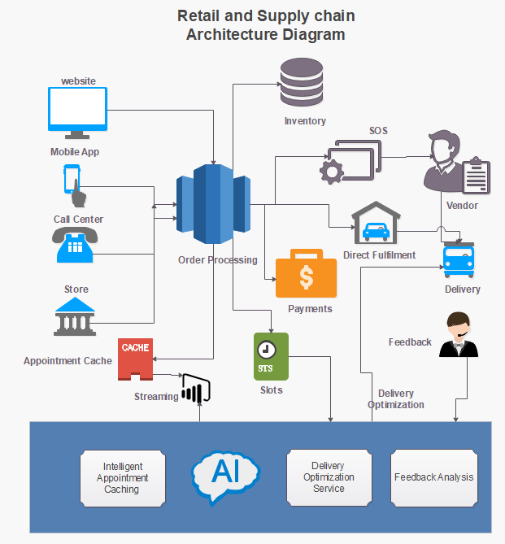
Retail System Architecture

Slide 7
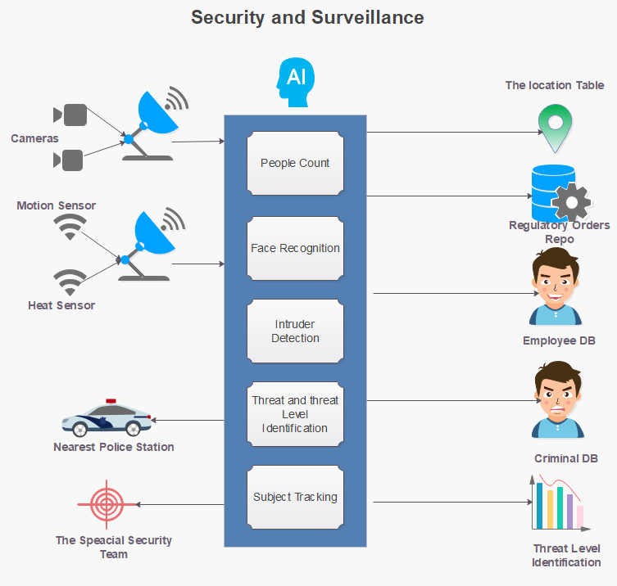
Security and Surveillance

Slide 8
Our Cool Stuff
Automated Attendance System
https://www.youtube.com/watch?v=7VDzO4PX96A&list=PLmQAMKHKeLZ_dmcPBxdiZ-1qN2iMexErg&index=3
Live Stream Face Recognition from Drone
https://www.youtube.com/watch?v=0tgaVavFXig&list=PLmQAMKHKeLZ_dmcPBxdiZ-1qN2iMexErg&index=6
Live Stream Object Detection from Drone
https://www.youtube.com/watch?v=0tgaVavFXig&list=PLmQAMKHKeLZ_dmcPBxdiZ-1qN2iMexErg&index=6
Automatic Number Plate detection System
https://www.youtube.com/watch?v=hBLdlx_U4L8&list=PLmQAMKHKeLZ_dmcPBxdiZ-1qN2iMexErg&index=5
And Many More…

Slide 9
Thank You

